Slide 1
Azure Kubernetes Services Overview
Tim Oleson

Slide 2
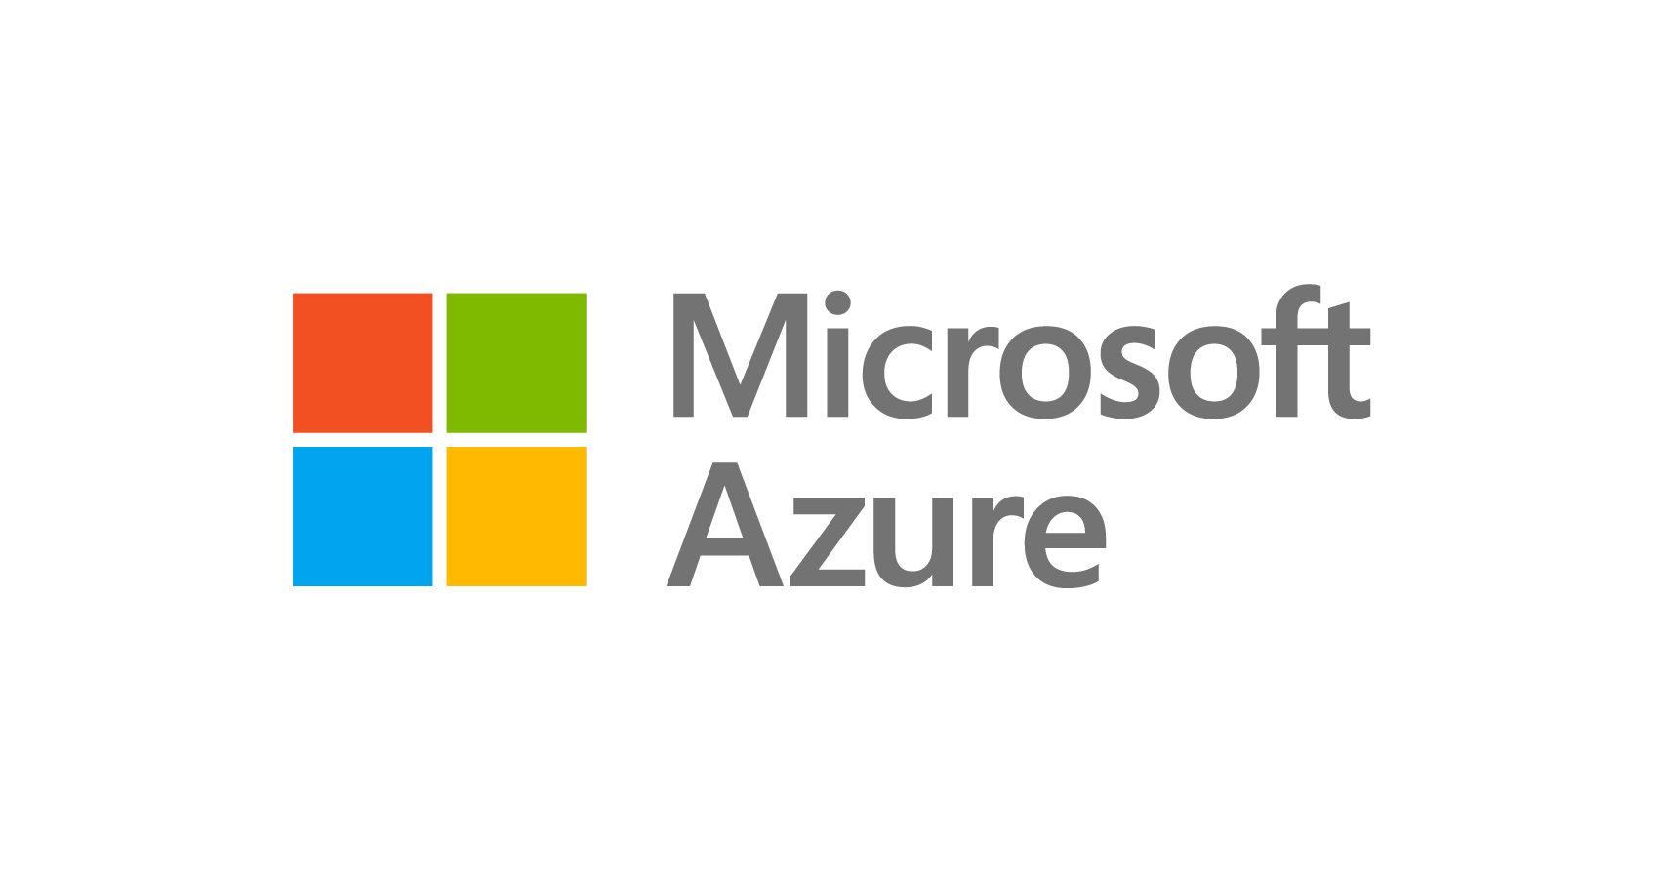

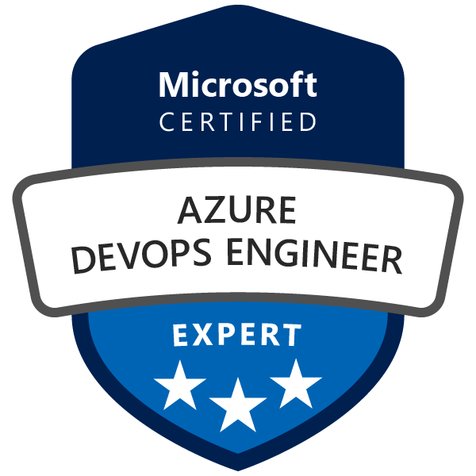
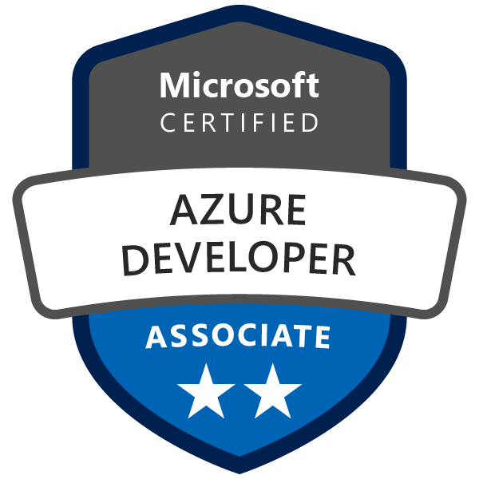
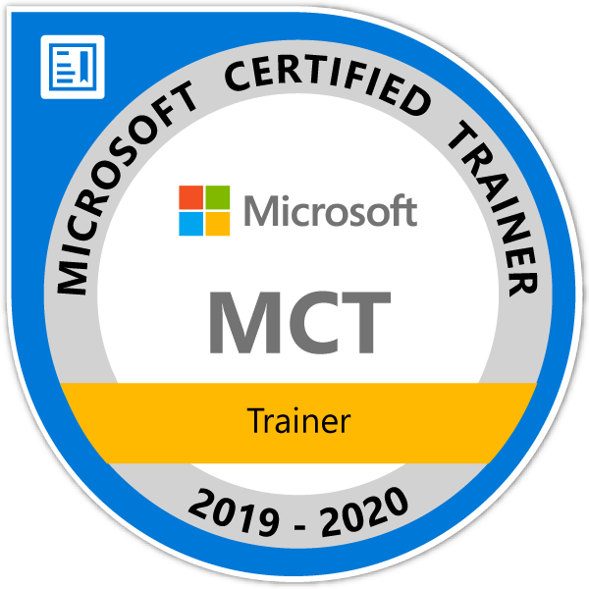

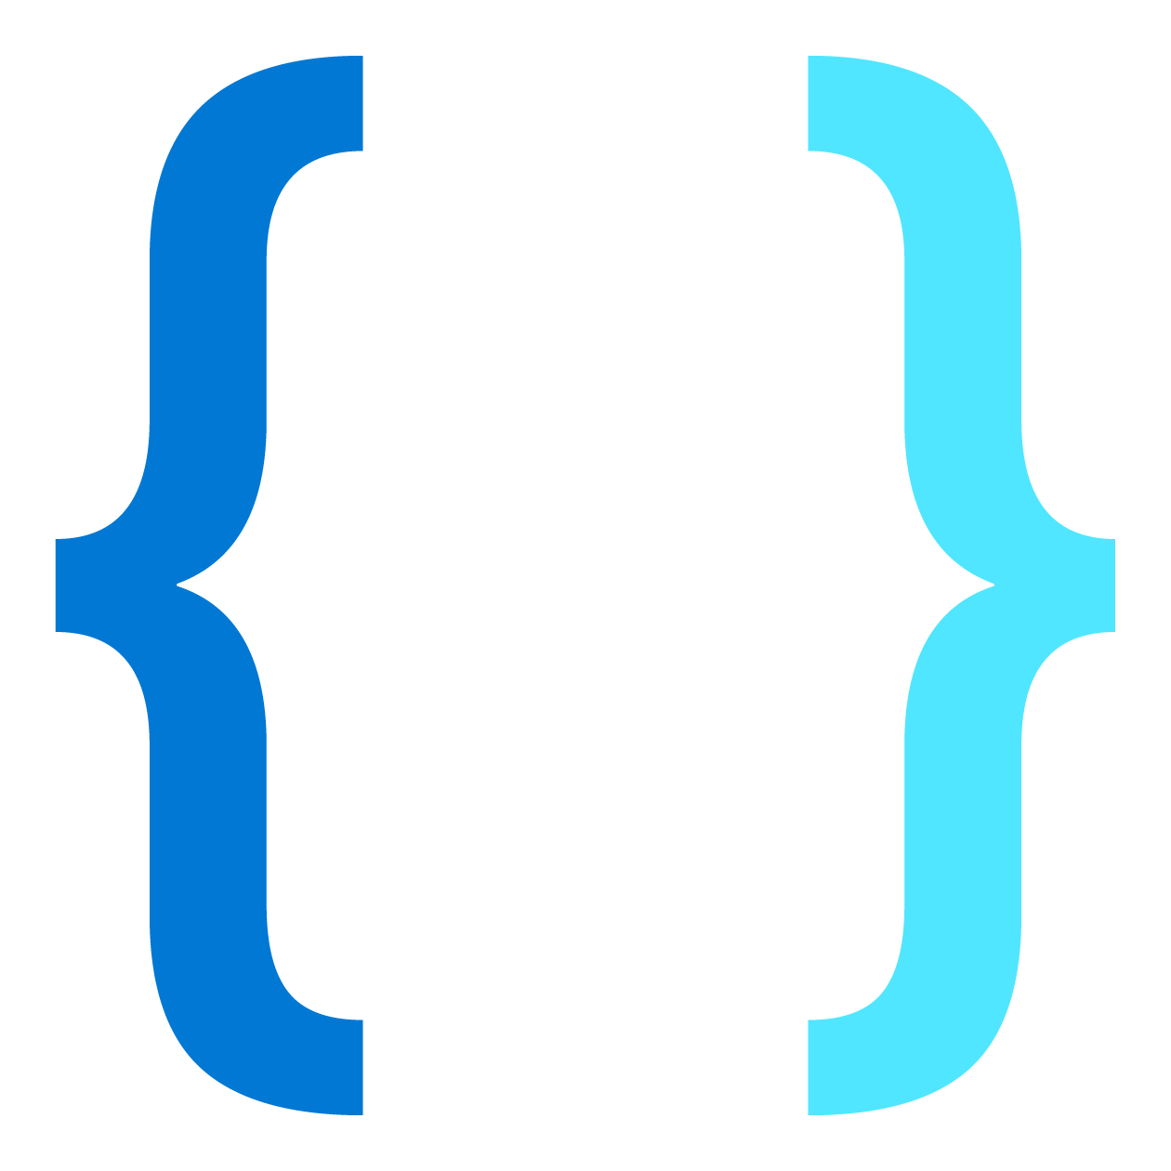
Tim Oleson
Customer Engineer
U.S. Army Retired SFC 24 yrs
Software Engineer 17 yrs
Web Developer 20 yrs
Aspiring Architect
Family: Marcela Oleson, Brandy(27), Tomas(17), Anna(7)
Passions: Domain Driven Design, Web Development, Object Oriented Design, SOLID Design Principles, Architecture,
Art, Photography, Digital Illustration, Bass Fishing and Break Dancing.
Tech: Azure PaaS, Cosmos DB(Data Modeling, Gremlin Api(graphDb)) , SQL Developer(Store Procedures, Functions) Azure Monitor(Application Insights), Asp.Net, .Net Core, .NodeJS, Angular, gRPC, Dockers, Azure Kubernetes Services, Http Restful Web APIs, Azure Service Bus(Message Broker, EventHub), Splunk Integration
Patterns: MVC, Factory, Microservices, Domain, Transact Script, Table Module
Languages and Scripting: C#, JavaScript, TypeScript, SQL, Linq, and learning C
Agile Methods: DevOps, Agile Scrum, Agile Scale, Spec Flow, Unit Testing, Behavioral Driven Design, Git(Distributed Version Control), Team Foundation Version Control (TFVC) (Centralized Version Control)
Heroes: Ragnar Lodbrok, Batman, Martin Fowler, Uncle Bob, Eric Evans, The Gang of Four

Slide 3
Agenda
Kubernetes Overview
Clusters
Pods
Labels and Annotations
Services
Deployment
ConfigMaps & Secrets
Volumes
Demos

Slide 4
Why is Kubernetes
Platform that manages container-based applications and orchestration
Provides Networking and storage components
Enables declarative approach to the deployment of your applications
To Maintain application in desired state

Slide 5
What is Kubernetes
External Load Balancer
Cluster
Cluster
A pool (federation) of virtual machines (nodes)
Node
Virtual Machine
Pod
Container
Services
Networking
Deployment
ReplicaSet
Volumes
Storage
Service (load balancer)
Kubectl appy deploy.yaml
Pod
Pod
Pod
Deployment
C
C
C
Volume
Volume
Volume
deploy.yaml
Kubernetes API
Node
Node
Node
Node
VM
VM
VM
VM
C
C
C

Slide 6
What is Kubernetes
Cluster
A pool (federation) of virtual machines (nodes)
Services
Networking
Node
Virtual Machine
Pod
Container
Deployment
ReplicaSet
Volumes
Storage
External Load Balancer
Cluster
Service (load balancer)
(Virtual Machine)
(Virtual Machine)
(Virtual Machine)
Node
Node
Node
Deployment
Pod
Pod
Pod
C
C
C
Volume
Volume
Volume
deploy.yaml
Kubernetes API
Kubectl appy deploy.yaml

Slide 7
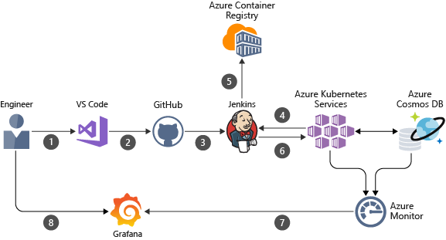
What is Kubernetes
Robust set of APIs for management operations
Build application with your preferred programming language , OS libraries, or messaging bus
Continuous delivery (CI/CD) tools integrate with Kubernetes to schedule and deploy releases

Slide 8
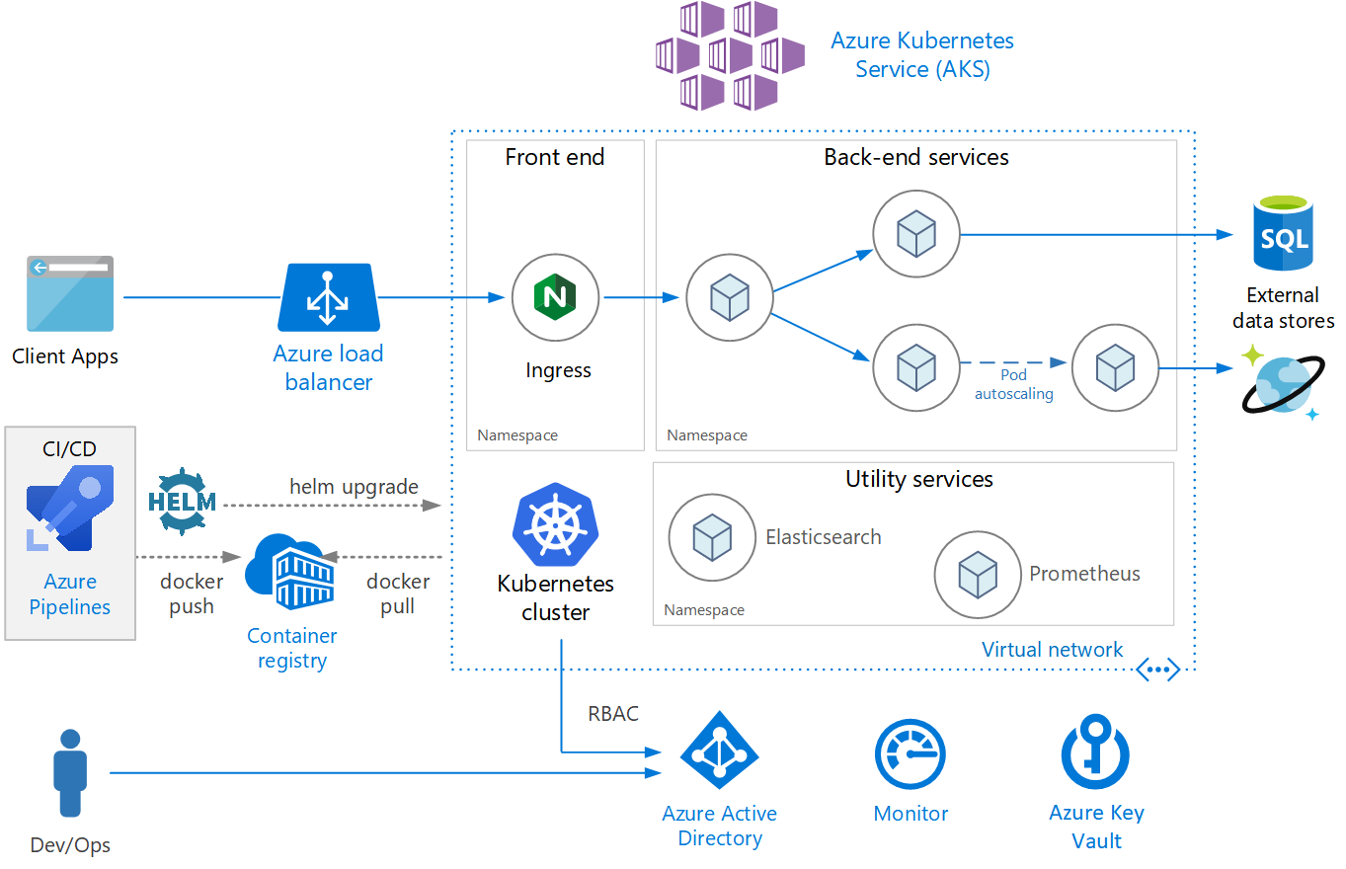
Azure Kubernetes Service
Managed Kubernetes service (Managed Instance)
Reduced complexity for deployment and core management task
Coordinated upgrades

Slide 9
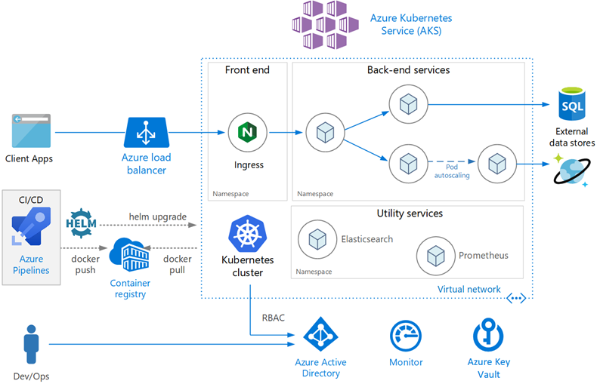
Azure Kubernetes Service
AKS Control plane is managed by the Azure Platform
Only pay for the nodes running your application
AKS is built on top of the open-source Azure Kubernetes Engine(aks-engine)

Slide 10
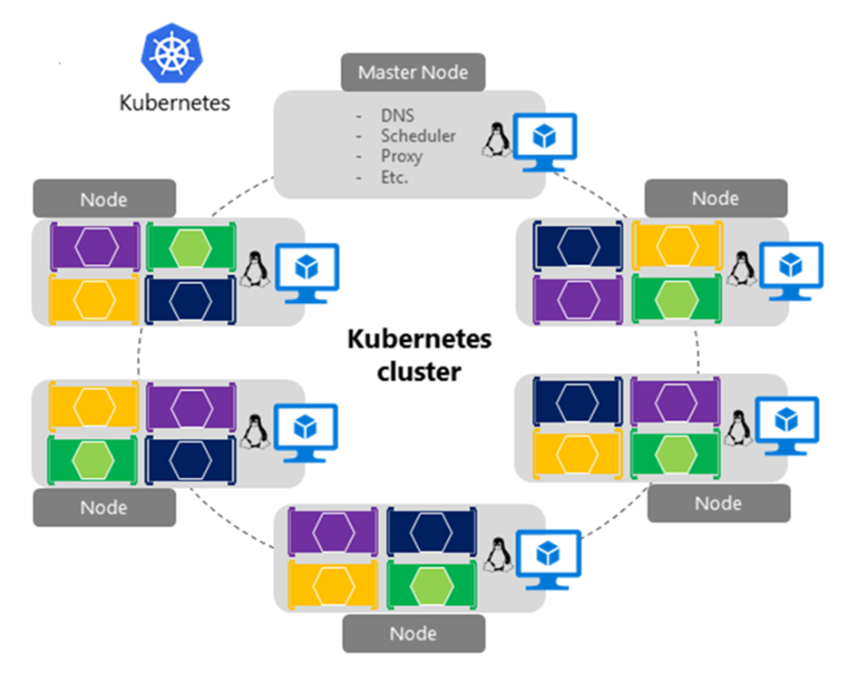
What is a cluster?
Orchestrators support cluster-based technology
A pool (federation) of virtual machines (nodes)
Forms highly-available environment
Start small with a few machines and can scale out to hundreds
Fully elastic with no single point of failure
Each node is aware of other nodes
Nodes can be heterogeneous, some small, some large

Slide 11
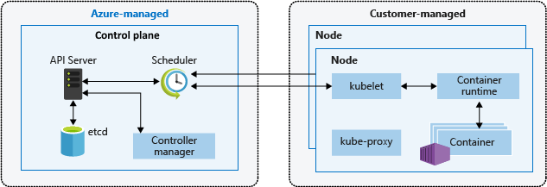
Kubernetes cluster architecture
A Kubernetes cluster is divided into two components:
Control plane nodes provide the core Kubernetes services and orchestration of the application workloads
Nodes run your application workloads

Slide 12
Control Plane
Control plane Automatically created and configured upon AKS Cluster creation
Managed Azure resource abstraction form the user
No cost for control plane only nodes that a part of the AKS Cluster(worker nodes)
Resides only on the region where you created the cluster

Slide 13
Control Plane Core Components
kube-apiserver
The API server is how the underlying Kubernetes APIs are exposed. This component provides the interaction for management tools, such as kubectl or the Kubernetes dashboard.
etcd
To maintain the state of your Kubernetes cluster and configuration, the highly available etcd is a key value store within Kubernetes.

Slide 14
Control Plane Core Components
kube-scheduler
When you create or scale applications, the Scheduler determines what nodes can run the workload and starts them.
kube-controller-manager
The Controller Manager oversees a number of smaller Controllers that perform actions such as replicating pods and handling node operations.

Slide 15
Azure Kubernetes Service
Single-tenant control plane
Dedicated API server, Scheduler
Ability to Define number and size of the nodes
Azure Platform configures the secure commination between the control plane and the nodes
Interaction occur through Kubernetes APIs such as kubectl or Kubernetes dashboard

Slide 16
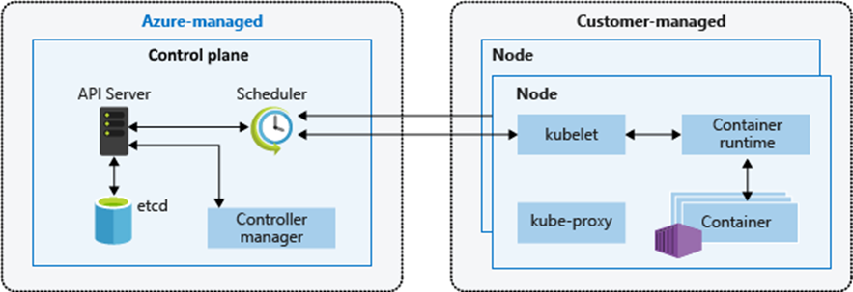
Managed Control Plan
You don’t need to configure components like highly available etcd store
No access to control plane directly
Upgrades are managed through Azure CLI or Azure Portal
Upgrades are made to the Control plane and then the nodes
View Control plane logs in Azure Monitor logs

Slide 17

Kubernetes Architecture Tour
Internet
Proxies route traffic across nodes and PODS
Master Node manages the entire cluster
kubectl
Command line utility to manage Kubernetes
Worker node
Kubelet
Kube-proxy
Control Plane
Container Runtime
Kubelet monitors the Node and PODs
Pod
Pod
API Server
Entry point for REST commands to the Master node
Worker nodes host containerized workloads
kube-controller-manager (replication, namespaces, serviceaccounts,…)
scheduler
Worker node
Kubelet
PODs are collections of containers deployed as a single unit
Deploys containers across the cluster based upon rules
Kube-proxy
Handles routine tasks in the cluster
Container Runtime
etcd
Pod
Pod
Key-value data store that maintains cluster state
Notes:
In its simplest form, Kubernetes is made of a central manager (aka master) and some worker.
The manager runs an API server, a scheduler, various controllers and a storage system to keep the state of the cluster, container settings, and the networking configuration.
api-server
Front-end control plane. Exposes API
controller-manager
Runs controllers, e.g. replication controller, node controller
scheduler
assigns pods to nodes
etcd
Highly available, distributed Cluster database.
add-ons
DNS, Heapster (enables monitoring and performance analysis), Dashboard, Logging
Kubelet
Primary node agent
Watches and runs assigned pods
Executes health probes and reports status
Kube-proxy
Enables network services
Container Runtime
Docker, rkt ..

Slide 18
How Do You Provision an AKS Cluster?
Azure Portal
Azure CLI (Command Line Interface)
Azure ARM Script

Slide 19
How Do You Manage AKS?
Kubectl is the official command line utility required to interact the Kubernetes cluster and the resources running upon it:
Under the hood, Kubectl connects to the cluster through an underlying API
Type of commands include…
Generic commands – manage Kubernetes objects
Cluster management commands
Troubleshooting commands
Deployment commands – deployment and scaling
Setting commands – configuration values
kubectl <command> <kubernetes object type> <object name> <flags>

Slide 20
Demo Provision an AKS Cluster
Tim Oleson
Notes:
Demo Link Create an AKS cluster in the portal - Azure Kubernetes Service | Microsoft Docs
Create an AKS cluster in the portal - Azure Kubernetes Service | Microsoft Docs

Slide 21
Namespaces
Deployments Logically Grouped
Notes:
https://thenewstack.io/kubernetes-deployments-work/

Slide 22
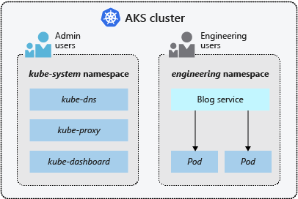
Namespaces
Kubernetes resources, such as pods and Deployments, are logically grouped into a namespace.
These groupings provide a way to logically divide an AKS cluster and restrict access to create, view, or manage resources.
Create namespaces to separate business groups
AKS Cluster Namespace
Default - This namespace is where pods and deployments are created by default when none is provided
kube-system - This namespace is where core resources exist, such as network features like DNS and proxy, or the Kubernetes dashboard.
kube-public - This namespace is typically not used, but can be used for resources to be visible across the whole cluster, and can be viewed by any user.

Slide 23
Pods
Tim Oleson

Slide 24
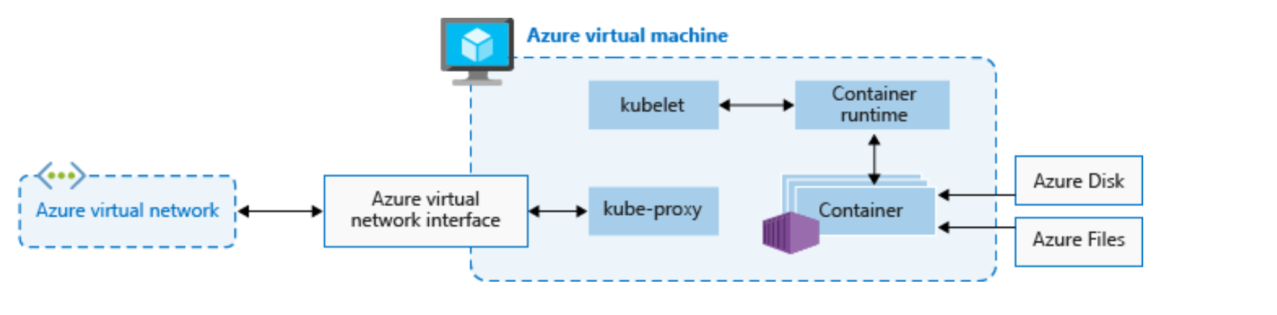
Nodes and node pools
AKS Cluster has one or more nodes
Nodes run on Azure Virtual Machines(VM)
VMs run the Kubernetes nodes components and container runtime:
The kubelet is the Kubernetes agent
Virtual networking is handled by the kube-proxy on each node
The container runtime for containers to run(Moby)

Slide 25
What are Pods?
The POD is smallest building block in Kubernetes…
A collection of co-located containers and volumes
Running in the same execution environment
Managed as a single atomic unit
You never directly run a container, instead you run a POD
Apps running in a POD share the same IP, port and communicate using native inter-process communication channels
Pods are immutable - if a change is made to a pod definition, a new pod is created, and the old pod is deleted
PODs are identified using labels (key-value pairs)…
app=voting-app; tier= frontend
Notes:
Pods are the atomic unit of deployments.
- Why should we put multiple containers in a pod? The question we should ask is:
Will these containers work correctly if they land on different machines?
- Containers in a pod share same namespaces but have separate cgroups: This will allow us to fine tune resource limits for containers in a pod

Slide 26
How Pods Work
kubectl
Worker node 1
Instruct the Master node to provision 2 replicas of a pod
Kubelet
Master node
Container Runtime
API Server
kube-controller-manager
scheduler
Worker node 2
Kubelet
Container Runtime
Stores pod specification in etcd data store
etcd
Notes:
1- Administrator sends pod creation request using kubectl command line tool. Pod specification is stored in etcd.
In production scenarios you don’t create a pod directly, since it cannot be scheduled on a different node automatically when the node is down and you cannot ensure exact number of replicas are running in the cluster. You should use a controller like ReplicaSet or Deployment to better manage availability and scalability of your pods.

Slide 27
How Pods Work
kubectl
Worker node 1
Kubelet
Master node
Container Runtime
API Server
kube-controller-manager
scheduler
Worker node 2
Assigns a node for each pod
Kubelet
Container Runtime
1. Pod = Worker Node 1
2. Pod = Worker Node 2
etcd
Notes:
2- Scheduler watches newly created pods that have no node assigned, and selects a node for them to run on.
Factors taken into account for scheduling decisions include individual and collective resource requirements, hardware/software/policy constraints, affinity and anti-affinity specifications, data locality, inter-workload interference and deadlines.
https://kubernetes.io/docs/concepts/overview/components/#kube-scheduler

Slide 28
How Pods Work
kubectl
Worker nodes check if there are pods assigned and provision them
Worker node 1
Kubelet
Master node
Container Runtime
Pod
API Server
kube-controller-manager
scheduler
Worker node 2
Kubelet
Container Runtime
1. Pod = Worker Node 1
2. Pod = Worker Node 2
Pod
etcd
Notes:
3- The kubelet takes a set of PodSpecs that are provided through various mechanisms (primarily through the apiserver) and ensures that the containers described in those PodSpecs are running and healthy.
https://kubernetes.io/docs/reference/command-line-tools-reference/kubelet/
https://kubernetes.io/docs/concepts/overview/components/#kubelet

Slide 29
How Pods Work
kubectl
Kube-controller-manager ensures the correct number of pods are running in the cluster
Worker node 1
Kubelet
Master node
Container Runtime
Pod
API Server
kube-controller-manager
scheduler
Worker node 2
Kubelet
Container Runtime
1. Pod = Worker Node 1
2. Pod = Worker Node 2
Pod
etcd
Notes:
Kube-controller-manager is a daemon that embeds the core control loops shipped with Kubernetes. In applications of robotics and automation, a control loop is a non-terminating loop that regulates the state of the system. In Kubernetes, a controller is a control loop that watches the shared state of the cluster through the apiserver and makes changes attempting to move the current state towards the desired state.
These controllers include:
Replication Controller: Responsible for maintaining the correct number of pods for every replication controller object in the system.
Node Controller
Endpoints Controller
Service Account & Token Controllers
https://kubernetes.io/docs/concepts/overview/components/#kube-controller-manager
https://kubernetes.io/docs/reference/command-line-tools-reference/kube-controller-manager/

Slide 30
Demo Creating a Pod
Tim Oleson
Notes:
https://docs.microsoft.com/en-us/azure/aks/tutorial-kubernetes-deploy-application
Md c:\DemoCreatePod
Cd c:\DemoCreatePod
Create new text file pod.yaml
Paste below text in pod.yaml text file and save
apiVersion: v1
kind: Pod
metadata:
name: label-demo
labels:
environment: production
app: nginx
spec:
containers:
- name: nginx
image: nginx:1.14.2
ports:
- containerPort: 80
Run apply command
kubectl apply -f pod.yaml
Run Get Pods
kubectl get pods
Run Describe
kubectl describe pod label-demo

Slide 31
Labels
Tim Oleson

Slide 32
Labels and Selectors
Labels are key/value pairs that are attached to objects, such as pods.
Labels can be used to organize and to select subsets of objects
Labels enable users to map their own organizational structures onto system objects in a loosely coupled fashion, without requiring clients to store these mappings.
apiVersion: v1
kind: Pod
metadata:
name: label-demo
labels:
environment: production
app: nginx
spec:
containers:
- name: nginx
image: nginx:1.14.2
ports:
- containerPort: 80
Notes:
Wrap replica set and provide administrative related features on top of that:
Self documented
Reproductible
Versioned
Simple rolling update and rollback
Deployment state lookup (progressing, complete, failed)
https://kubernetes.io/docs/concepts/workloads/controllers/deployment/#deployment-status

Slide 33
Labels and Selectors
Unlike names and UIDs, labels do not provide uniqueness. In general, we expect many objects to carry the same label(s).
The set of pods that a service targets is defined with a label selector. Similarly, the population of pods that a replicationcontroller should manage is also defined with a label selector.
selector:
matchLabels:
app: nginx
Notes:
Wrap replica set and provide administrative related features on top of that:
Self documented
Reproductible
Versioned
Simple rolling update and rollback
Deployment state lookup (progressing, complete, failed)
https://kubernetes.io/docs/concepts/workloads/controllers/deployment/#deployment-status

Slide 34
Annotations
You can use Kubernetes annotations to attach arbitrary non-identifying metadata to objects. Clients such as tools and libraries can retrieve this metadata
"metadata": {
"annotations": {
"key1" : "value1",
"key2" : "value2"
}
}
apiVersion: v1
kind: Pod
metadata:
name: annotations-demo
annotations:
imageregistry: "https://hub.docker.com/"
spec:
containers:
- name: nginx
image: nginx:1.14.2
ports:
- containerPort: 80

Slide 35
Deployment
Show Replica Sets and Deployments
Notes:
https://thenewstack.io/kubernetes-deployments-work/
https://docs.microsoft.com/en-us/azure/aks/tutorial-kubernetes-deploy-application

Slide 36
Desired State
Maintaining state of your application
Current State
Desired State

Slide 37
Deployments and YAML manifests
Deployment
apiVersion: apps/v1
kind: Deployment
metadata:
name: nginx
spec:
replicas: 3
selector:
matchLabels:
app: nginx
template:
metadata:
labels:
app: nginx
spec:
containers:
- name: nginx
image: mcr.microsoft.com/oss/nginx/nginx:1.15.2-alpine
ports:
- containerPort: 80
- containerPort: 443
resources:
requests:
cpu: 250m
memory: 64Mi
limits:
cpu: 500m
memory: 256Mi
ReplicaSet
Pod
Port 80
Port 443
Pod
Port 80
Port 443
Pod
Port 80
Port 443
Notes:
Wrap replica set and provide administrative related features on top of that:
Self documented
Reproductible
Versioned
Simple rolling update and rollback
Deployment state lookup (progressing, complete, failed)
https://kubernetes.io/docs/concepts/workloads/controllers/deployment/#deployment-status

Slide 38
What are Deployments Objects?
A Kubernetes object that manages releases, updates and scaling…
Controls PODs and replica set objects
Instructs the Kubernetes Deployment controller how to create and update instances of your services
Provide fine-grained control over how and when a new pod version is rolled out as well as rolled back to a previous state
The Kubernetes Deployment Controller reads the deployment and schedules the service instances onto individual nodes in the cluster
Deployment objects abstract provisioning operations…
To delete a set of pods, simply delete the deployment that controls them
To update a set of pods, edit the deployment definition and apply it
Notes:
Wrap replica set and provide administrative related features on top of that:
Self documented
Reproductible
Versioned
Simple rolling update and rollback
Deployment state lookup (progressing, complete, failed)
https://kubernetes.io/docs/concepts/workloads/controllers/deployment/#deployment-status

Slide 39
Deployments and YAML manifests
A deployment represents one or more identical pods, managed by the Kubernetes Deployment Controller.
A deployment defines the number of replicas (pods) to create, and the Kubernetes Scheduler ensures that if pods or nodes encounter problems, additional pods are scheduled on healthy nodes.
You can update deployments to change the configuration of pods, container image used, or attached storage.
Deployment Controller drains and terminates a given number of replicas, creates replicas from the new deployment definition, and continues the process until all replicas in the deployment are updated.
Notes:
Wrap replica set and provide administrative related features on top of that:
Self documented
Reproductible
Versioned
Simple rolling update and rollback
Deployment state lookup (progressing, complete, failed)
https://kubernetes.io/docs/concepts/workloads/controllers/deployment/#deployment-status

Slide 40
StatefulSets and DaemonSets
Deployments may be sufficient for stateless applications, but not for applications that require a persistent naming convention or storage.
Deployment Controller doesn't look at how replicas are distributed across the nodes.
When you need to determine where a replica is deployed there are Two types of resources
StatefulSets - Maintain the state of applications beyond an individual pod lifecycle, such as storage.
DaemonSets - Ensure a running instance on each node, early in the Kubernetes bootstrap process.

Slide 41
StatefulSets
Modern application development use stateless applications
StatefulSets can be used for stateful applications, such as applications that include database components.
StatefulSet is similar to a deployment in that one or more identical pods are created and managed.
Replicas in a StatefulSet follow a graceful, sequential approach to deployment, scale, upgrades, and terminations.
StatefulSet (as replicas are rescheduled) the naming convention, network names, and storage persist.
StatefulSet are scheduled and run across any available node in an AKS cluster. If you need to ensure that at least one pod in your Set runs on a node, you can instead use a DaemonSet.

Slide 42
DaemonSets
specific log collection or monitoring needs, you may need to run a given pod on all, or selected, nodes.
DaemonSet is again used to deploy one or more identical pods, but the DaemonSet Controller ensures that each node specified runs an instance of the pod.
DaemonSet Controller can schedule pods on nodes early in the cluster boot process, before the default Kubernetes scheduler has started

Slide 43
How Deployment Works
Deployment
ReplicaSet v1
ReplicaSet v2
Worker node 1
Worker node 2
Pod
Pod
Pod
Pod
Notes:
1 – Deploy the first version of your deployment with 2 replica of your pod
- It will create the underlying replica set V1 and assign 2 instances of the pods throughout the cluster
2 – Update the deployment with V2 version
- It will create a new replica set V2 which will spin up 2 new pods tagged as V2.
- Once they are up and running, the V1 replica set is torn down with all attached pods.
Add Trans to remove v1

Slide 44
Demo Deployment
Show Replica Sets and Deployments
Notes:
https://thenewstack.io/kubernetes-deployments-work/
https://docs.microsoft.com/en-us/azure/aks/tutorial-kubernetes-deploy-application
Navigate to Yaml file location azure-vote-all-in-one-redis.yaml
Cd C:\DockerDemo\ExampleCode\azure-voting-app-redis
az aks get-credentials --resource-group gap-rg –name GapAKSCluster
Deploy the application
kubectl apply -f azure-vote-all-in-one-redis.yaml
Test Application
Monitor progress
kubectl get service azure-vote-front –watch
Output
External IP Pending
azure-vote-front LoadBalancer 10.0.34.242 <pending> 80:30676/TCP 5s
When the EXTERNAL-IP address changes from pending to an actual public IP address, use CTRL-C to stop the kubectl watch process. The following example output shows a valid public IP address assigned to the service:
azure-vote-front LoadBalancer 10.0.34.242 52.179.23.131 80:30676/TCP 67s
See the application in action, open a web browser to the external IP address of your service:
52.179.23.131 in browser

Slide 45
Services
Tim Oleson
Notes:
https://thenewstack.io/kubernetes-deployments-work/

Slide 46
What is a Service?
Frontend Service
-- service selectors
tier=frontend
app=voting-app
An abstraction that defines a logical set of loosely-coupled PODs and a policy by which to access them
A Services is defined with a YAML markup file
They use “selectors” to define which pods to represent
Used to load balance traffic to your PODs
e.g. I want to expose the frontend of my voting app, so my service will expose all pods with the labels app=voting-app and tier=frontend
Backend Service
-- service selectors
tier=backend
app=voting-app
Worker node 1
Pod
Pod
Worker node 1
Pod
Notes:
Misleading generic term because it is actually a connector that can be thought of as a load balancer
To expose a set of pods internally to the cluster or externally.
Use label selectors to target particular pods.
This is what we could use to implement blue-green deployment when rolling out new pods (see previous slides for details).

Slide 47
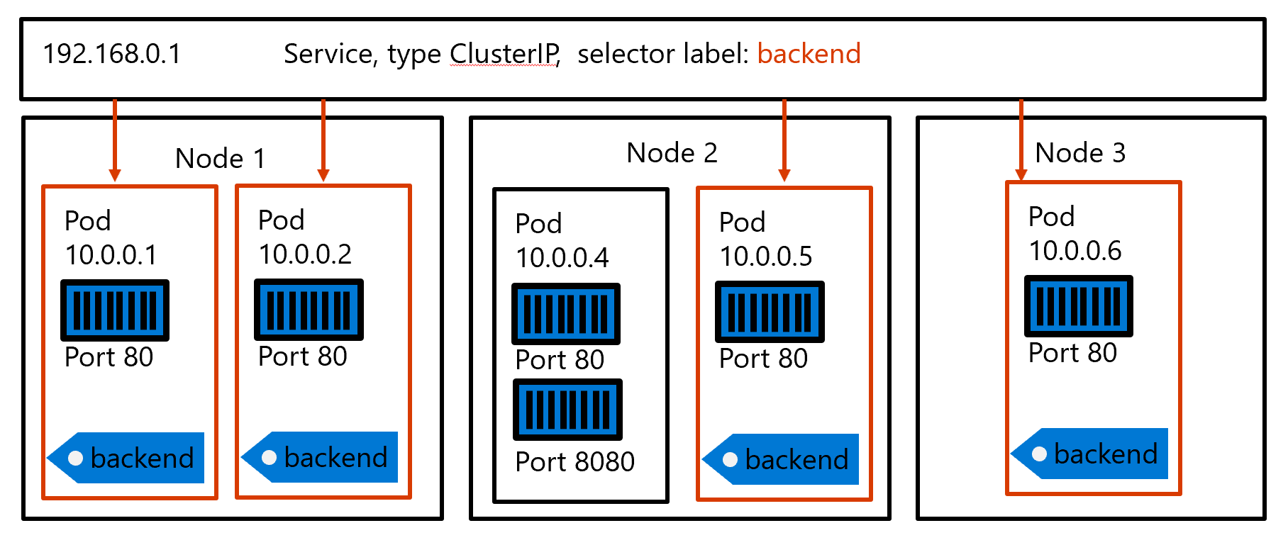
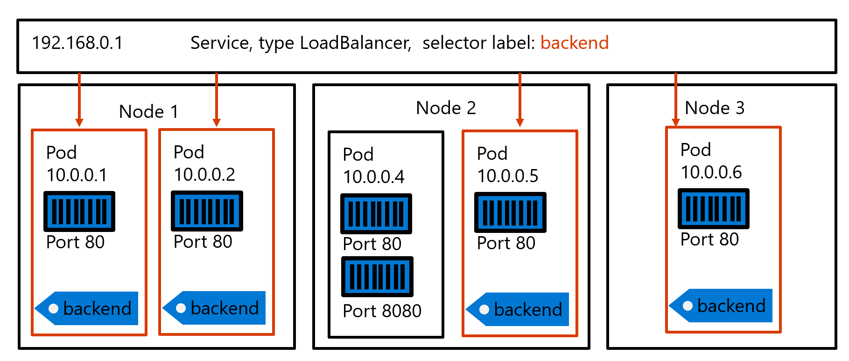
What is a Service?
Type: ClusterIP
An abstraction that defines a logical set of loosely-coupled PODs and a policy by which to access them
A Services is defined with a YAML markup file
They use “selectors” to define which pods to represent
Used to load balance traffic to your PODs
Public IP 37.16.207.0.1
Type: LoadBalancer
Notes:
Misleading generic term because it is actually a connector that can be thought of as a load balancer
To expose a set of pods internally to the cluster or externally.
Use label selectors to target particular pods.
This is what we could use to implement blue-green deployment when rolling out new pods (see previous slides for details).

Slide 48
What is a Service?
Service
192.168.0.1 Service, type LoadBalancer, selector label: backend
Node 1
Node 2
Node 3
Pod
10.0.0.1
Port 80
Pod
10.0.0.2
Port 80
Pod
10.0.0.4
Port 80
Port 8080
Pod
10.0.0.5
Port 80
Pod
10.0.0.6
Port 80
backend
backend
backend
backend

Slide 49
What is a Service?
Kubernetes, Services logically group pods to allow for direct access via an IP address or DNS name and on a specific port.
distribute traffic using a load balancer.
Complex routing of application traffic can also be achieved with Ingress Controllers.
Security and filtering of the network traffic for pods is possible with Kubernetes network policies.
Notes:
Misleading generic term because it is actually a connector that can be thought of as a load balancer
To expose a set of pods internally to the cluster or externally.
Use label selectors to target particular pods.
This is what we could use to implement blue-green deployment when rolling out new pods (see previous slides for details).

Slide 50
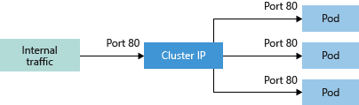
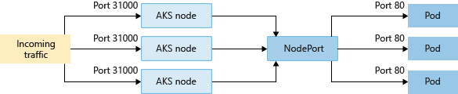
Service
Kubernetes uses Services to logically group a set of pods together and provide network connectivity.
NodePort - Creates a port mapping on the underlying node that allows the application to be accessed directly with the node IP address and port.

Slide 51
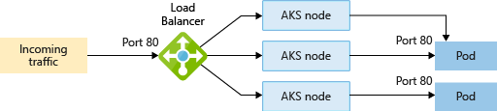
Service
LoadBalancer - Creates an Azure load balancer resource, configures an external IP address, and connects the requested pods to the load balancer backend pool. To allow customers' traffic to reach the application, load balancing rules are created on the desired ports.

Slide 52
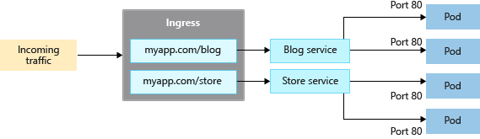
Ingress controllers
Load balancer type Service, an underlying Azure load balancer resource is created.
Load balancer is configured to distribute traffic to the pods in your Service on a given port.
Load balancer only works at layer 4 - the Service is unaware of the actual applications, and can't make any additional routing considerations.
Ingress controllers work at layer 7, and can use more intelligent rules to distribute application traffic. A common use of an Ingress controller is to route HTTP traffic to different applications based on the inbound URL.

Slide 53
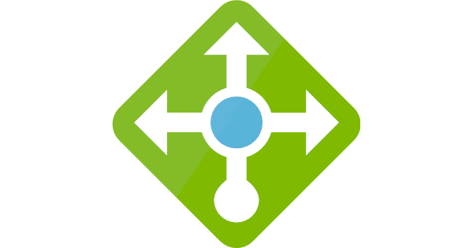
Service Object Types
PODs are not exposed outside of the immediate cluster without a Service object – they allow PODs to receive traffic
There are different types of services that expose your pod in different ways
ClusterIP: Provides a single IP internal to the cluster to represent a set of pods
NodePort: Reserves a specified port on the node to represent a set of pods
LoadBalancer: Creates a public-facing, load-balanced IP address
Cluster
Worker node
Node Port 32001
Frontend Cluster IP
192.168.0.1
Pod
Client
Node Port 32002
Backend Cluster IP
192.168.0.2
Pod
Public IP 1 -> Node IP:32001
Notes:
ClusterIP is the default option. There is no access to the services with ClusterIP type from outside of the cluster.
NodePort type makes every node open the same port and redirect requests to services endpoints (pods). You’ll be able to contact the NodePort service, from outside the cluster, by requesting <NodeIP>:<NodePort>.
LoadBalancer Exposes the service externally using a cloud provider’s load balancer. Load balancer will allocate a public IP for each service with this type, and route requests to backend pool of nodes to their ports defined in NodePort property. (Nodes should still open a port for a service with LoadBalancer type, so that cloud provider’s load balancer can route requests to that port)
https://kubernetes.io/docs/concepts/services-networking/service/#publishing-services-service-types

Slide 54
How Services Work
kubectl
Worker node 2
Worker node 1
Create a pod
Pod1
Master node
API Server
Kube-proxy
Kube-proxy
scheduler
etcd
Notes:
Kube-proxy does the load-balance magic:
- Watches new services in the cluster
- Programs iptables rules to redirect Cluster IP requests to backend pods
- Update iptables rules when pods are created or deleted

Slide 55
How Services Work
kubectl
Worker node 2
Worker node 1
Create a service
Pod1
Master node
Service
API Server
Kube-proxy
Kube-proxy
iptable rules
iptable rules
scheduler
Service ClusterIP -> Pod1 IP
Service ClusterIP -> Pod1 IP
etcd
Notes:
When a service is created, the kube-proxy component installs iptable rules which select a backend pod. Endpoint pods are identified by labels matching service’s labels. This happens in every node within the cluster.
"iptables proxy mode" is one of the working modes of kube-proxy, which enables the node to route requests from kernel space. For more information on iptables mode: https://kubernetes.io/docs/concepts/services-networking/service/#proxy-mode-iptables
Why not use round robin dns? https://kubernetes.io/docs/concepts/services-networking/service/#why-not-use-round-robin-dns

Slide 56
How Services Work
kubectl
Worker node 2
Worker node 1
Scale the application
Pod1
Pod2
Master node
Service
API Server
Kube-proxy
Kube-proxy
iptable rules
iptable rules
scheduler
Service ClusterIP -> Pod1 IP
Service ClusterIP -> Pod1 IP
Service ClusterIP -> Pod2 IP
Service ClusterIP -> Pod2 IP
etcd
Notes:
When the application is scaled and new pods are created with matching labels, kube-proxy gets notified and update iptable rules.

Slide 57
How Services Work
kubectl
Worker node 2
Worker node 1
Pod1
Pod2
Master node
Service
API Server
Kube-proxy
Kube-proxy
iptable rules
iptable rules
scheduler
Service ClusterIP -> Pod1 IP
Service ClusterIP -> Pod1 IP
Service ClusterIP -> Pod2 IP
Service ClusterIP -> Pod2 IP
etcd
Access to the service from outside of the cluster
Pods are load-balanced via iptable rules
Notes:
When a client reaches to the public IP of the services, cloud load balancer will redirect the request to one of the nodes. It is then routed to one of the pods running in any of the nodes.

Slide 58
Services
Kubernetes Service Demo

Slide 59
ConfigMaps & Secrets
Tim Oleson
Notes:
https://thenewstack.io/kubernetes-deployments-work/

Slide 60
ConfigMaps
A ConfigMap is an API object used to store non-confidential data in key-value pairs. Pods can consume ConfigMaps as environment variables, command-line arguments, or as configuration files in a volume.
A ConfigMap allows you to decouple environment-specific configuration from your container images, so that your applications are easily portable
Use a ConfigMap for setting configuration data separately from application code.
apiVersion: v1
kind: ConfigMap
metadata:
name: game-demo
data:
# property-like keys; each key maps to a simple value
player_initial_lives: "3"
ui_properties_file_name: "user-interface.properties"
# file-like keys
game.properties: |
enemy.types=aliens,monsters
player.maximum-lives=5
user-interface.properties: |
color.good=purple
color.bad=yellow
allow.textmode=true
Notes:
https://kubernetes.io/docs/concepts/configuration/configmap/

Slide 61
ConfigMaps
There are four different ways that you can use a ConfigMap to configure a container inside a Pod:
Inside a container command and args
Environment variables for a container
Add a file in read-only volume, for the application to read
Write code to run inside the Pod that uses the Kubernetes API to read a ConfigMap
These different methods lend themselves to different ways of modeling the data being consumed. For the first three methods, the kubelet uses the data from the ConfigMap when it launches container(s) for a Pod
The fourth method means you have to write code to read the ConfigMap and its data. However, because you're using the Kubernetes API directly, your application can subscribe to get updates whenever the ConfigMap changes, and react when that happens. By accessing the Kubernetes API directly, this technique also lets you access a ConfigMap in a different namespace
Notes:
Wrap replica set and provide administrative related features on top of that:
Self documented
Reproductible
Versioned
Simple rolling update and rollback
Deployment state lookup (progressing, complete, failed)
https://kubernetes.io/docs/concepts/workloads/controllers/deployment/#deployment-status

Slide 62
Secrets
Kubernetes Secrets let you store and manage sensitive information, such as passwords, OAuth tokens, and ssh keys.
Storing confidential information in a Secret is safer and more flexible than putting them in a Pod definition or in a container image.
Kubernetes Secrets are, by default, stored as unencrypted base64-encoded strings
By default they can be retrieved - as plain text - by anyone with API access, or anyone with access to Kubernetes' underlying data store, etcd.
Enable Encryption at Rest for Secrets.
Enable or configure RBAC rules that restrict reading and writing the Secret. Be aware that secrets can be obtained implicitly by anyone with the permission to create a Pod.
A Secret can be used with a Pod in three ways:
As files in a volume mounted on one or more of its containers.
As container environment variable.
By the kubelet when pulling images for the Pod.
Notes:
Wrap replica set and provide administrative related features on top of that:
Self documented
Reproductible
Versioned
Simple rolling update and rollback
Deployment state lookup (progressing, complete, failed)
https://kubernetes.io/docs/concepts/workloads/controllers/deployment/#deployment-status

Slide 63
Volumes
Storage
Notes:
https://thenewstack.io/kubernetes-deployments-work/

Slide 64
Types of Storage
Volumes
Persistent volumes
Storage classes
Persistent volume claims
Notes:
Wrap replica set and provide administrative related features on top of that:
Self documented
Reproductible
Versioned
Simple rolling update and rollback
Deployment state lookup (progressing, complete, failed)
https://kubernetes.io/docs/concepts/workloads/controllers/deployment/#deployment-status

Slide 65
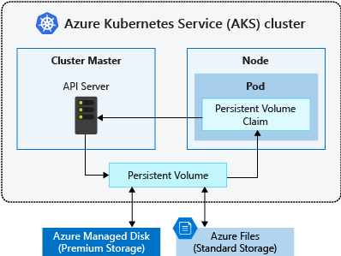
What are Volumes?
Volumes are storage
Applications often need to be able to store and retrieve data
A volume represents a way to store, retrieve, and persist data across pods and through the application lifecycle.
Notes:
https://docs.microsoft.com/en-us/azure/aks/concepts-storage

Slide 66
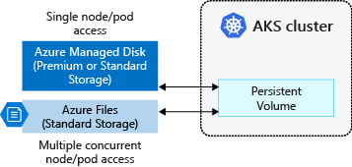
Persistent volumes
A persistent volume (PV) is a storage resource created and managed by the Kubernetes API that can exist beyond the lifetime of an individual pod.
Notes:
https://docs.microsoft.com/en-us/azure/aks/concepts-storage

Slide 67
Storage classes
The StorageClass also defines the reclaimPolicy.
reclaimPolicy controls the behavior of the underlying Azure storage resource when the pod is deleted and the persistent volume may no longer be required.
The underlying storage resource can be deleted, or retained for use with a future pod.
Storage Class Yaml:
kind: StorageClass
apiVersion: storage.k8s.io/v1
metadata:
name: managed-premium
provisioner: kubernetes.io/azure-disk
reclaimPolicy: Retain
parameters:
storageaccounttype: Premium_LRS
kind: Managed
Notes:
https://docs.microsoft.com/en-us/azure/aks/concepts-storage

Slide 68
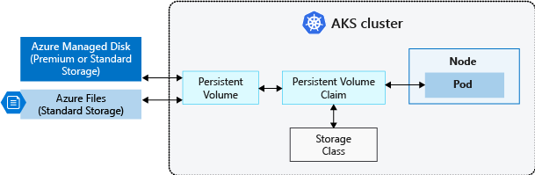
Persistent volume claims
A PersistentVolumeClaim requests either Disk or File storage of a particular StorageClass, access mode, and size.
Kubernetes API server can dynamically provision the underlying storage resource in Azure if there is no existing resource to fulfill the claim based on the defined StorageClass.
pod definition includes the volume mount once the volume has been connected to the pod.
Notes:
https://docs.microsoft.com/en-us/azure/aks/concepts-storage

Slide 69
Persistent volume claims
PersistentVolume is bound to a PersistentVolumeClaim once an available storage resource has been assigned to the pod requesting it. There is a 1:1 mapping of persistent volumes to claims.
The following example YAML manifest shows a persistent volume claim that uses the managed-premium StorageClass and requests a Disk 5 Gigs in size:
apiVersion: v1
kind: PersistentVolumeClaim
metadata:
name: azure-managed-disk
spec:
accessModes:
- ReadWriteOnce
storageClassName: managed-premium
resources:
requests:
storage: 5Gi
Notes:
https://docs.microsoft.com/en-us/azure/aks/concepts-storage

Slide 70
Helm
Tim Oleson
Notes:
https://thenewstack.io/kubernetes-deployments-work/

Slide 71


Helm
Package/Deployment manager for Kubernetes
Used to deploy an application or a component of a larger application
Allow you to easily take highly repeatable or commonly used applications and services and deploy them to the Kubernetes cluster

Slide 72
Helm Chart
Collection of .yaml files that describe a set of Kubernetes resources
Single chart may be used to deploy a simple application or even a full web app stack
Created as files in a directory tree

Slide 73
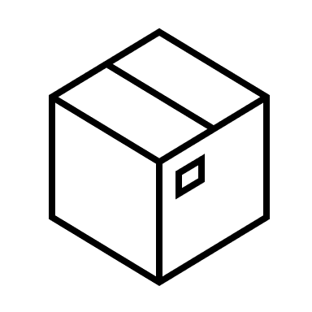

Helm
Package/Deployment manager for Kubernetes
Used to deploy an application or a component of a larger application
Allow you to easily take highly repeatable or commonly used applications and services and deploy them to the Kubernetes cluster

Slide 74
Helm Chart
Chart
(templates)
Values
(config)
Package/collection of .yaml files that describe a set of Kubernetes resources
Single chart may be used to deploy a simple application or even a full web app stack
Can use public charts to install apps into cluster (e.g. wordpress, mongodb)
Kubernetes cluster
Release
(resources)

Slide 75
Questions
Notes:
https://thenewstack.io/kubernetes-deployments-work/

